Slide 1


Custom Components for Android
It’s easier than you think!
Paul Lammertsma
CTO

Slide 2
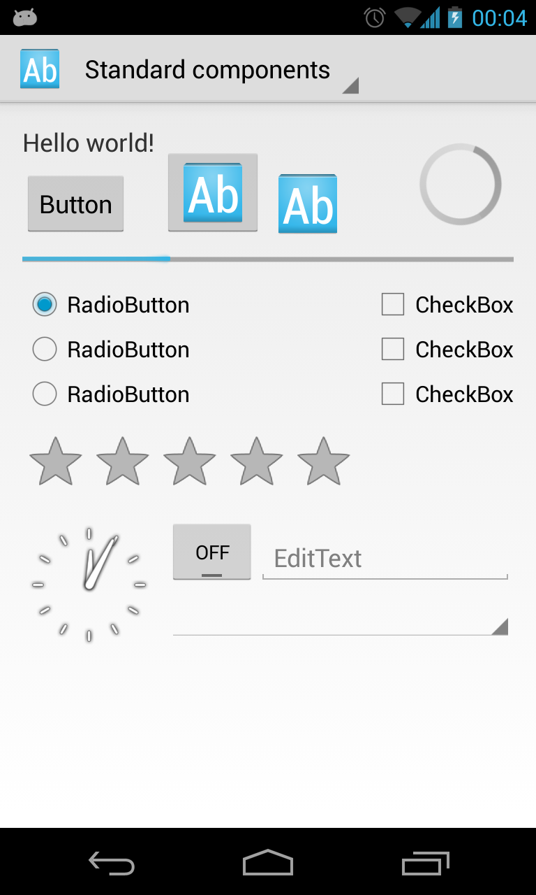
Components?

Slide 3

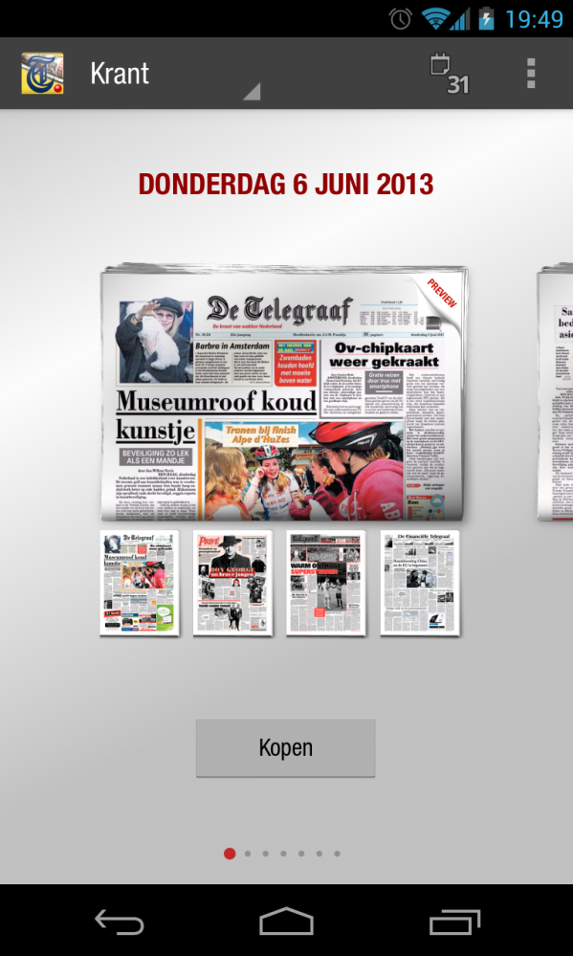
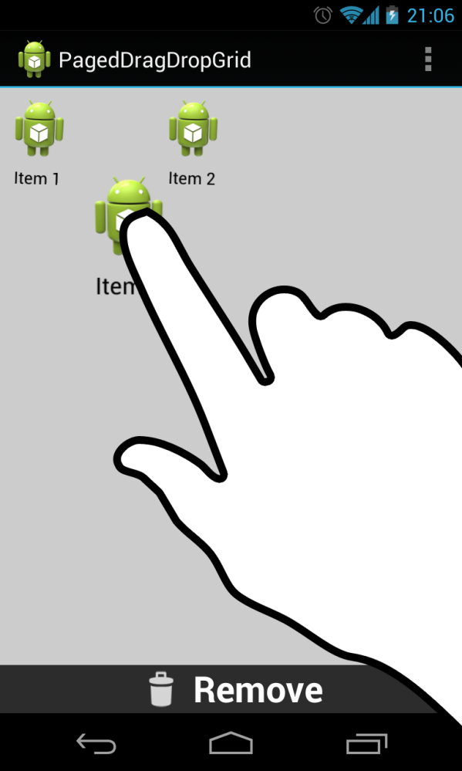
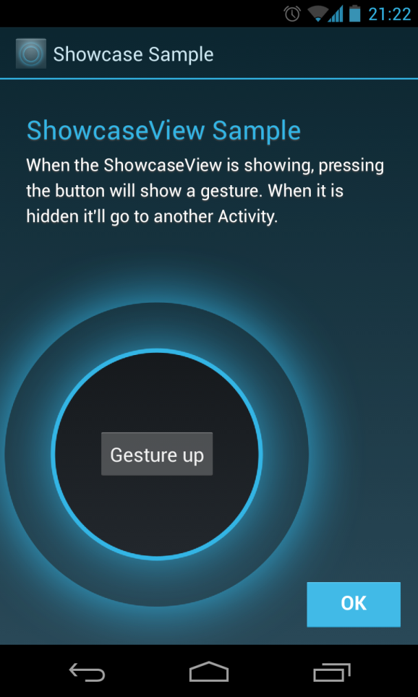

Custom components?
Notes:
Roman Nurik’s WizardPager (not really a custom component; an extension of Fragments with a model): https://plus.google.com/113735310430199015092/posts/6cVymZvn3f4

Slide 4
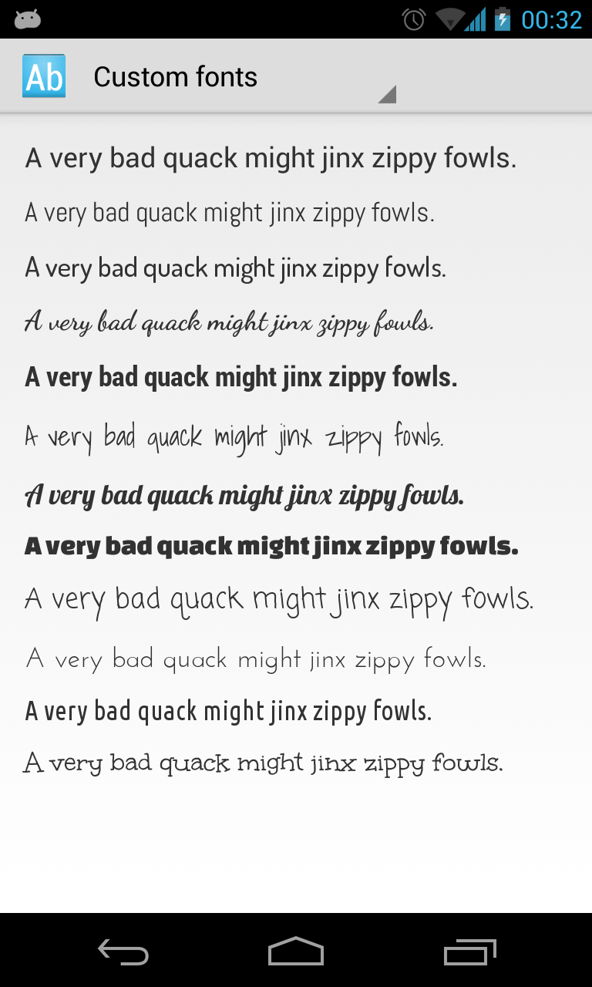
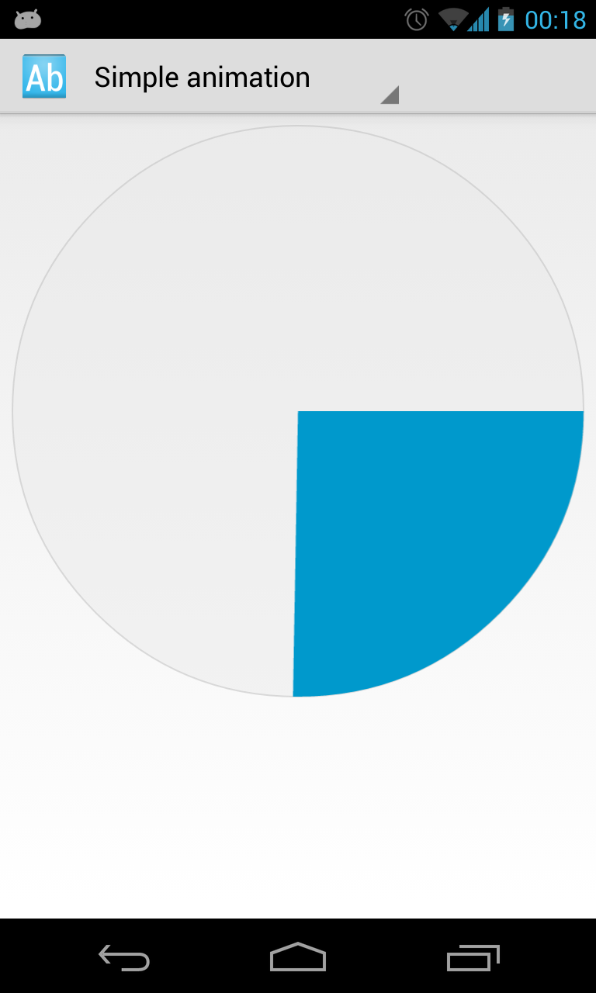
Custom components?
Notes:
Roman Nurik’s WizardPager (not really a custom component; an extension of Fragments with a model): https://plus.google.com/113735310430199015092/posts/6cVymZvn3f4

Slide 5
Why not just…
…write it out in a layout?
Sometimes you can
Beware of using lots of ViewGroups
Beware of unnecessary layouting
Sometimes you simply can’t
<LinearLayout …
android:orientation=”horizontal">
<LinearLayout …
android:orientation="vertical”>
…
</LinearLayout>
<LinearLayout …
android:orientation="vertical”>
…
</LinearLayout>
</LinearLayout>
Notes:
If you’re trying to make something pretty, like a fancy animation that would otherwise need constant layouting, consider a custom component
If you’re trying to position graphics in a particular way, you might otherwise end up with lots of (nested) ViewGroups

Slide 6
Why not just…
…write it out in code?
Keep your views and models separated!
View
res/layout
View
res/layout
Model
Activity
t1 = new TextView(context);
t1.setBackground(d);
t1.setTextColor(c);
<TextView …/>
new TextView(context)
t2 = new TextView(context);
t2.setBackground(d);
t2.setTextColor(c);
t3 = new TextView(context);
t3.setBackground(d);
t3.setTextColor(c);
Notes:
Adhere to MVC
This also avoids DRY code

Slide 7
Why not just…
…write it out in some clumsy combination of a layout and code?
We will!
Notes:
Except, it won’t be clumsy
It will be all polymorphic and fit nicely in the MVC pattern

Slide 8
Back to fonts
Notes:
Our example

Slide 9
At the root of any component…
android.widget.View
“The basic building block of all Android’s UI components.”
—d.android.com
Notes:
The basic building block of all Android’s UI components

Slide 10
FontTextView
Simple constructor to use when creating a view from code.
public class FontTextView extends TextView {
public FontTextView(Context context) {
super(context);
}
public FontTextView(Context context, AttributeSet attrs) {
super(context, attrs);
}
public FontTextView(Context context, AttributeSet attrs, int defStyle) {
super(context, attrs, defStyle);
}
}
public void setTypeface(String typeface) {
FontUtil.setTypeface(this, typeface);
}
Constructor that is called when inflating a view from XML.
extends View
Perform inflation from XML and apply a class-specific base style.

Slide 11
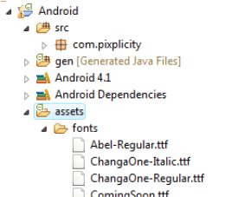
FontUtil
public class FontUtil {
public static void setTypeface(TextView view, String typefaceName) {
Typeface typeface = Typeface.createFromAsset(
view.getContext().getAssets(),
"fonts/" + typefaceName);
view.setTypeface(typeface);
}
}
We should probably reuse typefaces.

Slide 12
FontUtil
public static void setTypeface(TextView view, String typefaceName) {
Typeface typeface =
getTypeface(view.getContext(), typefaceName);
view.setTypeface(typeface);
}
public static Typeface getTypeface(Context context, String typefaceName) {
return Typeface.createFromAsset(
context.getAssets(),
"fonts/" + typefaceName);
}
private static final Map<String, Typeface> FONTS = new HashMap<String, Typeface>();
public static void setTypeface(TextView view, String typefaceName) {
view.setTypeface(getTypeface(view.getContext(), typefaceName));
}
public static Typeface getTypeface(Context context, String typefaceName) {
Typeface typeface = FONTS.get(typefaceName);
if (typeface == null) {
typeface = Typeface.createFromAsset(
context.getAssets(),
"fonts/" + typefaceName);
FONTS.put(typefaceName, typeface);
}
return typeface;
}

Slide 13
Layout
<LinearLayout
xmlns:android="http://schemas.android.com/apk/res/android"
xmlns:tools="http://schemas.android.com/tools"
android:layout_width="match_parent"
android:layout_height="wrap_content"
android:orientation="vertical"
tools:context=".MainActivity" >
<com.pixplicity.mobdevcon.widgets.FontTextView
style="@style/SampleText"
android:layout_width="wrap_content"
android:layout_height="wrap_content" />
</LinearLayout>
Provide the fully qualified name to the custom component.

Slide 14
Attributes
<?xml version="1.0" encoding="utf-8"?>
<resources>
<declare-styleable name="FontTextView">
<attr name="typeface" format="string" />
</declare-styleable>
</resources>
<?xml version="1.0" encoding="utf-8"?>
<resources>
<attr name="typeface" format="string" />
<declare-styleable name="FontTextView">
<attr name="typeface" />
</declare-styleable>
</resources>
Definition
Reference

Slide 15
FontTextView
public class FontTextView extends TextView {
public FontTextView(Context context) {
super(context);
}
public FontTextView(Context context, AttributeSet attrs) {
super(context, attrs);
}
public FontTextView(Context context, AttributeSet attrs, int defStyle) {
super(context, attrs, defStyle);
}
…
}
init(context, null, 0);
init(context, attrs, 0);
init(context, attrs, defStyle);

Slide 16
FontTextView
Setting attributes directly from the layout, or indirectly from the style.
private void init(Context context, AttributeSet attrs, int defStyle) {
if (attrs != null) {
final TypedArray a = context.obtainStyledAttributes(
attrs, R.styleable.FontTextView, defStyle, 0);
final String typeface =
a.getString(R.styleable.FontTextView_typeface);
a.recycle();
if (typeface != null) {
setTypeface(typeface);
}
}
}
public void setTypeface(String typeface) {
FontUtil.setTypeface(this, typeface);
}
<declare-styleable name="FontTextView">
<attr name="typeface" />
</declare-styleable>
Setting attributes through code.

Slide 17
Layout
Add a namespace declaration for our package…
<LinearLayout
xmlns:android="http://schemas.android.com/apk/res/android"
xmlns:tools="http://schemas.android.com/tools"
android:layout_width="match_parent"
android:layout_height="wrap_content"
android:orientation="vertical"
tools:context=".MainActivity" >
<com.pixplicity.mobdevcon.widgets.FontTextView
style="@style/SampleText"
android:layout_width="wrap_content"
android:layout_height="wrap_content"
/>
</LinearLayout>
<LinearLayout
xmlns:android="http://schemas.android.com/apk/res/android"
xmlns:app=
xmlns:tools="http://schemas.android.com/tools"
android:layout_width="match_parent"
android:layout_height="wrap_content"
android:orientation="vertical"
tools:context=".MainActivity" >
<com.pixplicity.mobdevcon.widgets.FontTextView
style="@style/SampleText"
android:layout_width="wrap_content"
android:layout_height="wrap_content"
/>
</LinearLayout>
<LinearLayout
xmlns:android="http://schemas.android.com/apk/res/android"
xmlns:app=
xmlns:tools="http://schemas.android.com/tools"
android:layout_width="match_parent"
android:layout_height="wrap_content"
android:orientation="vertical"
tools:context=".MainActivity" >
<com.pixplicity.mobdevcon.widgets.FontTextView
style="@style/SampleText"
android:layout_width="wrap_content"
android:layout_height="wrap_content"
app:typeface= />
</LinearLayout>
…so we can use it here.

Slide 18
Layout
<LinearLayout
xmlns:android="http://schemas.android.com/apk/res/android"
xmlns:app="http://schemas.android.com/apk/res-auto"
xmlns:tools="http://schemas.android.com/tools"
android:layout_width="match_parent"
android:layout_height="wrap_content"
android:orientation="vertical"
tools:context=".MainActivity" >
<com.pixplicity.mobdevcon.widgets.FontTextView
style="@style/SampleText"
android:layout_width="wrap_content"
android:layout_height="wrap_content"
app:typeface="Abel-Regular.ttf" />
</LinearLayout>
/apk/res/com.pixplicity.mobdevcon

Slide 19
Demo: fonts

Slide 20
Styles
<?xml version="1.0" encoding="utf-8"?>
<resources>
<style name="SampleText" parent="@android:style/Widget.TextView">
<item name="android:text">@string/pangram</item>
<item name="android:textSize">18sp</item>
</style>
</resources>
<?xml version="1.0" encoding="utf-8"?>
<resources>
<style name="SampleText" parent="@android:style/Widget.TextView">
<item name="android:text">@string/pangram</item>
<item name="android:textSize">18sp</item>
<item name="com.pixplicity.mobdevcon:typeface"> </item>
</style>
</resources>
<?xml version="1.0" encoding="utf-8"?>
<resources>
<style name="SampleText" parent="@android:style/Widget.TextView">
<item name="android:text">@string/pangram</item>
<item name="android:textSize">18sp</item>
<item name="com.pixplicity.mobdevcon:typeface">Abel-Regular.ttf</item>
</style>
</resources>
Provide the package name.

Slide 21
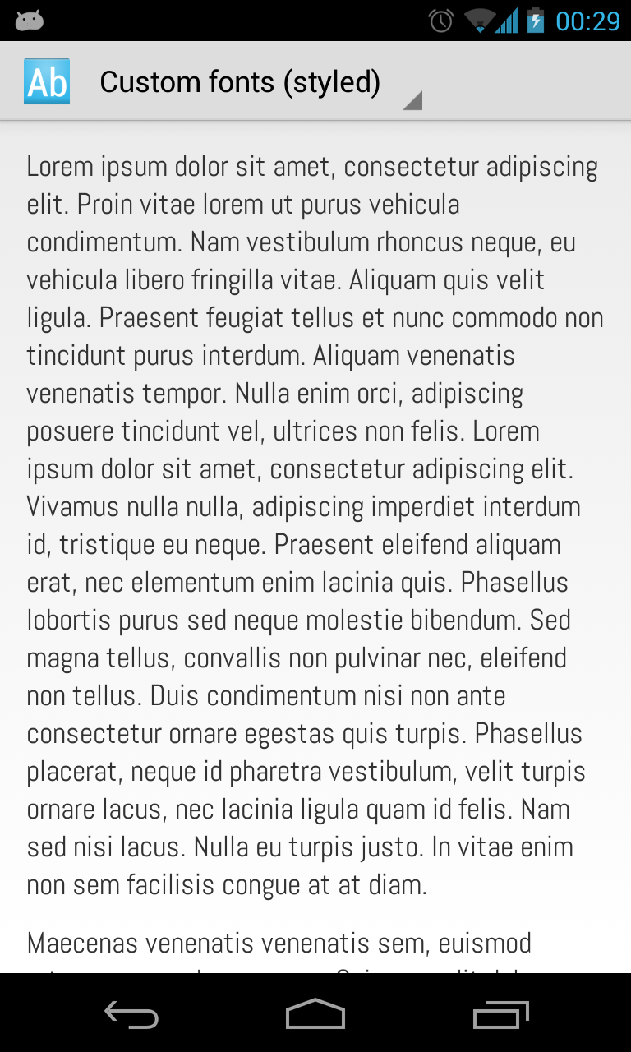
Demo: styled fonts

Slide 22
Another custom view

Slide 23
SimpleAnimatedView
public class SimpleAnimatedView extends View {
private final Paint mPaintFg = new Paint(Paint.ANTI_ALIAS_FLAG);
private final Paint mPaintLn = new Paint(Paint.ANTI_ALIAS_FLAG);
private final Paint mPaintBg = new Paint(Paint.ANTI_ALIAS_FLAG);
…
public void init(Context context, AttributeSet attrs, int defStyle) {
mPaintBg.setStyle(Paint.Style.FILL);
mPaintBg.setColor(Color.argb(128, 233, 233, 233));
mPaintLn.setStyle(Paint.Style.STROKE);
mPaintLn.setColor(Color.argb(128, 187, 187, 187));
mPaintLn.setStrokeWidth(2);
mPaintFg.setStyle(Paint.Style.FILL);
mPaintFg.setColor(Color.argb(255, 0, 153, 204));
}
}
Allocate objects you intend to use in draw & layout once…
…and reference them.

Slide 24
SimpleAnimatedView
@Override
protected void onMeasure(int widthMeasureSpec, int heightMeasureSpec) {
setMeasuredDimension(width, height);
}
MeasureSpec.makeMeasureSpec(
widthInPx,
MeasureSpec.EXACTLY);
Information about how big the ViewParent wants this View to be.
MeasureSpec is a packed int containing a size and a mode code.
widthInPx = MeasureSpec.getSize(
widthMeasureSpec);
widthMode = MeasureSpec.getMode(
widthMeasureSpec);
Contract: call before returning.
Notes:
onMeasure determines a size for a View (and for ViewGroup, its children recursively)

Slide 25
SimpleTextView
@Override
protected void onMeasure(int widthMeasureSpec, int heightMeasureSpec) {
// Measure text width
int w = (int) mTextPaint.measureText(mText)
+ getPaddingLeft() + getPaddingRight();
// Measure text height
int h = (int) (-mTextPaint.ascent(mText) + mTextPaint.descent(mText))
+ getPaddingLeft() + getPaddingRight();
setMeasuredDimension(w, h);
}
Notes:
onMeasure determines a size for a View (and for ViewGroup, its children recursively)

Slide 26
SimpleAnimatedView
@Override
protected void onMeasure(int widthMeasureSpec, int heightMeasureSpec) {
// Try for a width based on our minimum
int minW = getSuggestedMinimumWidth();
int w = resolveSizeAndState(minW, widthMeasureSpec, 0);
// Set the height according to the width as our control should be
// square
int minH = MeasureSpec.getSize(w);
int h = resolveSizeAndState(minH, heightMeasureSpec, 0);
setMeasuredDimension(w, h);
}
Notes:
onMeasure determines a size for a View (and for ViewGroup, its children recursively)

Slide 27
SimpleAnimatedView
@Override
protected void onMeasure(int widthMeasureSpec, int heightMeasureSpec) {
// Determine horizontal and vertical padding
int paddingX = getPaddingLeft() + getPaddingRight();
int paddingY = getPaddingBottom() + getPaddingTop();
// Try for a width based on our minimum including horizontal padding
int minW = getSuggestedMinimumWidth() + paddingX;
int w = resolveSizeAndState(minW, widthMeasureSpec, 0);
// Set the height according to the width as our control should be
// square, again compensating for padding
int minH = MeasureSpec.getSize(w) - paddingX + paddingY;
int h = resolveSizeAndState(minH, heightMeasureSpec, 0);
setMeasuredDimension(w, h);
}
Notes:
onMeasure determines a size for a View (and for ViewGroup, its children recursively)

Slide 28
SimpleAnimatedView
@Override
protected void onLayout(boolean changed, int l, int t, int r, int b) {
}
Information about where the ViewParent wants the View to be.
Notes:
onMeasure determines a size for a View (and for ViewGroup, its children recursively)

Slide 29
SimpleAnimatedView
@Override
protected void onLayout(boolean changed, int l, int t, int r, int b) {
// Typically used in ViewGroups to inform its children where to go;
// we won’t override onLayout for our View
super.onLayout(changed, l, t, r, b);
}
Notes:
onMeasure determines a size for a View (and for ViewGroup, its children recursively)

Slide 30
SimpleAnimatedView
@Override
protected void onSizeChanged(int w, int h, int oldw, int oldh) {
super.onSizeChanged(w, h, oldw, oldh);
// Set the drawing location, accounting for padding
mRect.left = getPaddingLeft();
mRect.top = getPaddingTop();
float diameter = Math.min(
w - mRect.left - getPaddingRight(),
h - mRect.top - getPaddingBottom());
mRect.right = mRect.left + diameter;
mRect.bottom = mRect.top + diameter;
mRadius = diameter / 2;
}

Slide 31
SimpleAnimatedView
@Override
protected void onDraw(Canvas canvas) {
super.onDraw(canvas);
canvas.drawCircle(
mRect.left + mRadius,
mRect.top + mRadius,
mRadius, mPaintBg);
canvas.drawCircle(
mRect.left + mRadius,
mRect.top + mRadius,
mRadius, mPaintLn);
canvas.drawArc(
mRect,
mStartAngle,
mSweepAngle - mStartAngle,
true, mPaintFg);
}

Slide 32
SimpleAnimatedView
protected final Runnable animator = new Runnable() {
@Override
public void run() {
// Change some parameters used in onDraw()
mSweepAngle++;
nextFrame();
invalidate();
}
};
@TargetApi(Build.VERSION_CODES.JELLY_BEAN)
protected void nextFrame() {
if (Build.VERSION.SDK_INT < Build.VERSION_CODES.JELLY_BEAN) {
postDelayed(animator, 16);
} else {
postOnAnimation(animator);
}
}
Invokes redrawing of the View.
Schedule drawing the next frame.

Slide 33
Demo: simple animation

Slide 34
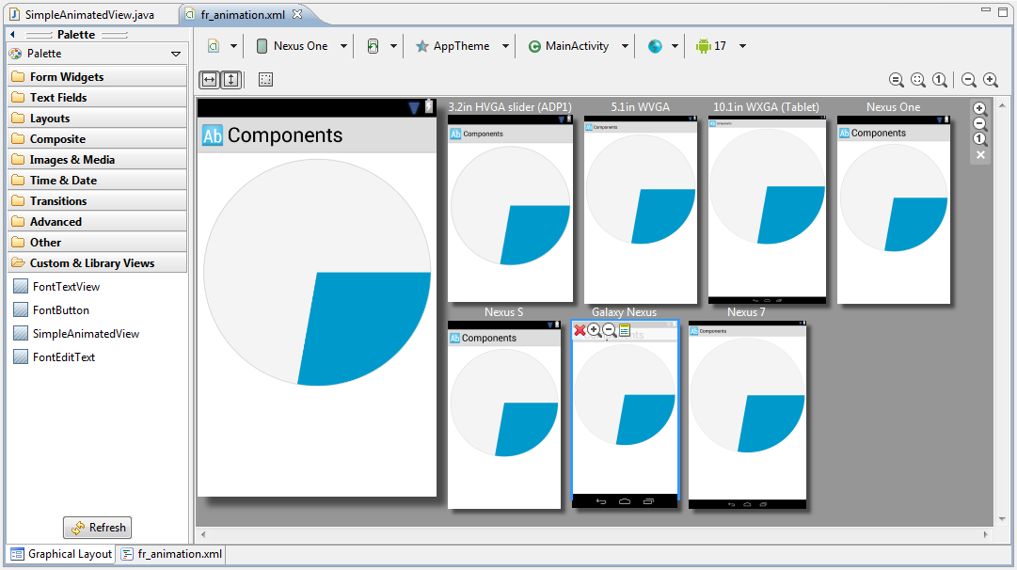
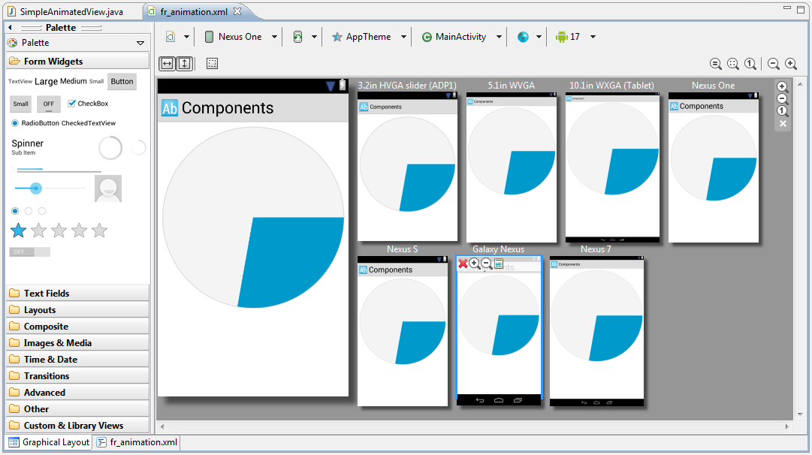
Bonus: ADT

Slide 35
What we’ve done
Wrote a custom component
Created custom components in layouts
Define custom attributes
Use styles with custom attributes
Custom measuring
Custom drawing

Slide 36
Things to be wary of
TypedArray a = null;
try {
a = context.obtainStyledAttributes(
attrs, R.styleable.FontTextView, defStyle, 0);
final String typeface =
a.getString(R.styleable.FontTextView_typeface);
} finally {
}
TypedArray a = null;
try {
a = context.obtainStyledAttributes(
attrs, R.styleable.FontTextView, defStyle, 0);
final String typeface =
a.getString(R.styleable.FontTextView_typeface);
} finally {
if (a != null) a.recycle();
}
Don’t forget to recycle AttributeSets

Slide 37
Things to be wary of
@Override
protected void onDraw(Canvas canvas) {
super.onDraw(canvas);
Paint paint = new Paint(Paint.ANTI_ALIAS_FLAG);
paint.setStyle(Paint.Style.FILL);
paint.setColor(Color.RED);
canvas.drawArc(new RectF(0, 0, mSize, mSize), 0, mAngle, true, paint);
}
@Override
protected void onDraw(Canvas canvas) {
super.onDraw(canvas);
Paint paint = new Paint(Paint.ANTI_ALIAS_FLAG);
paint.setStyle(Paint.Style.FILL);
paint.setColor(Color.RED);
canvas.drawArc(new RectF(0, 0, mSize, mSize), 0, mAngle, true, paint);
}
Avoid object allocations in draw/layout operations
In other words, listen to Lint!

Slide 38
Things to be wary of
@Override
protected void onLayout(boolean changed, int l, int t, int r, int b) {
super.onLayout(changed, l, t, r, b);
if (mViewToShowIfSpace != null
&& b < ((ViewGroup) getParent()).getHeight()) {
addView(mViewToShowIfSpace);
mViewToShowIfSpace = null;
}
}
@Override
protected void onLayout(boolean changed, int l, int t, int r, int b) {
super.onLayout(changed, l, t, r, b);
if (mViewToShowIfSpace != null
&& b < ((ViewGroup) getParent()).getHeight()) {
addView(mViewToShowIfSpace);
mViewToShowIfSpace = null;
}
}
ViewGroup’s onLayout() is not the place for changing the view hierarchy
If you insist, use the -InLayout() methods
Notes:
From DevBytes with Chet Haase: https://plus.google.com/104755487586666698979/posts/dXABXJHBa8n

Slide 39
Things to be wary of
private void nextFrame() {
postDelayed(animator, 16);
}
@TargetApi(Build.VERSION_CODES.JELLY_BEAN)
private void nextFrame() {
if (Build.VERSION.SDK_INT < Build.VERSION_CODES.JELLY_BEAN) {
postDelayed(animator, 16);
} else {
postOnAnimation(animator);
}
}
Perform draw events in V-sync for JB

Slide 40

Other resources than me
d.android.com
Training
Notes:
Feb 21, 2013 by Rich Hyndman: https://plus.google.com/115995639636688350464/posts/EJ8sqwP7jxU

Slide 41
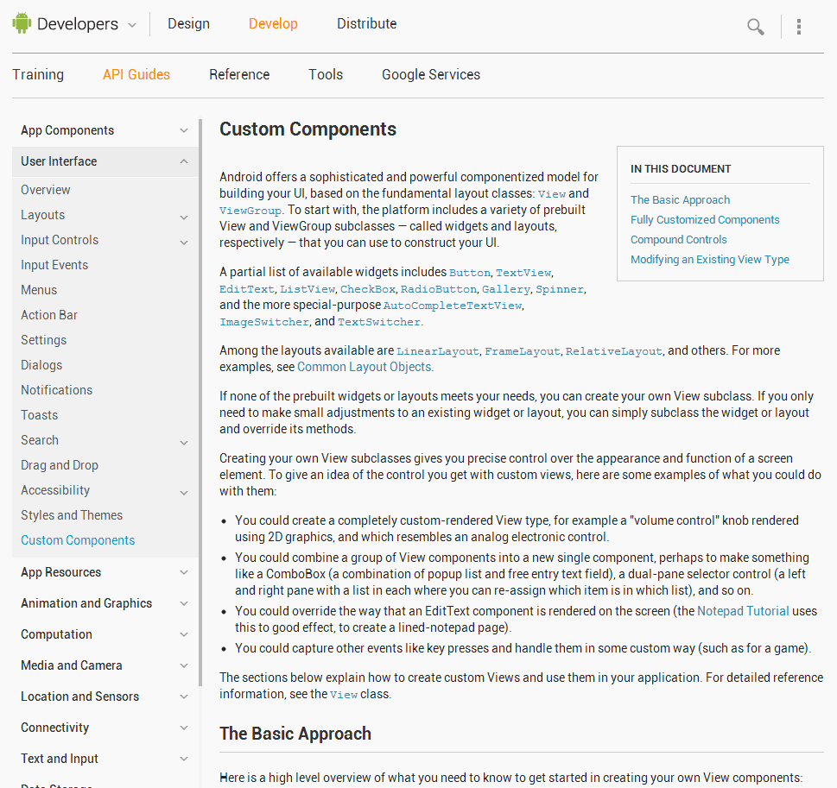
Other resources than me
d.android.com
Guide

Slide 42
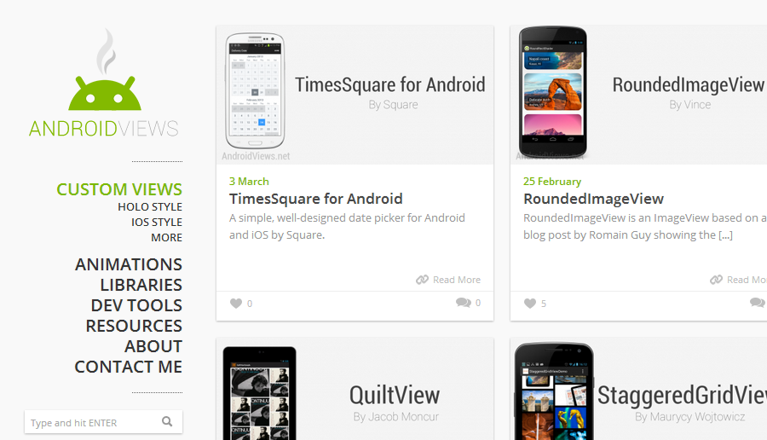
Other resources than me
AndroidViews.net

Slide 43
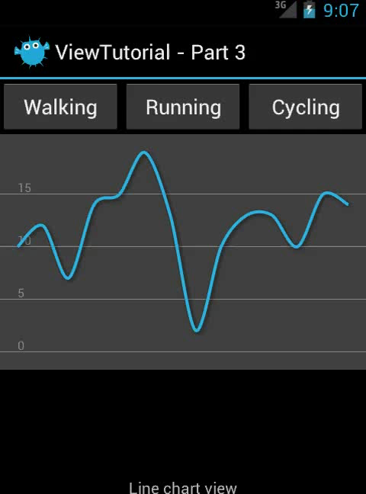
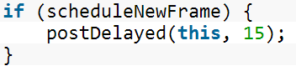
Other resources than me
Smooth animations
blog.jayway.com
Use the Choreographer on JB:
postOnAnimation(this);
Notes:
By Anders Ericsson: http://www.jayway.com/2012/08/29/creating-custom-android-views-part-3-animating-your-custom-views-smoothly/

Slide 44
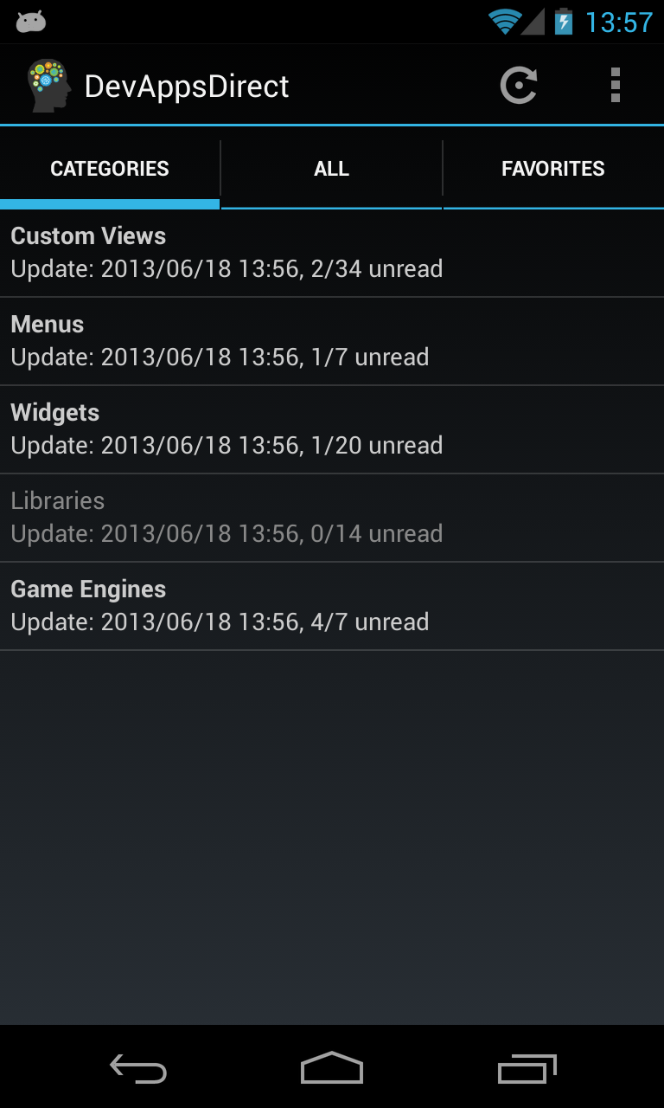
Other resources than me
DevAppsDirect

Slide 45
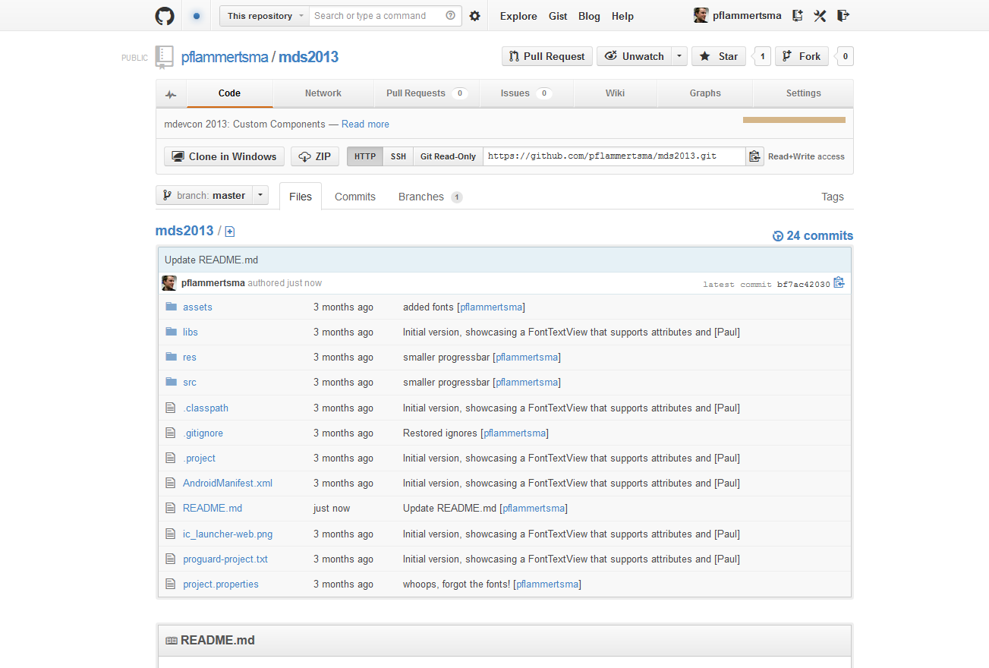

Resources that are me
Grab the code at:
github.com/pflammertsma/mobdevcon

Slide 46
Custom Components for Android
It’s easier than you think!
Paul Lammertsma
CTO

